Slide 1
Visualization
Using PowerBI

Slide 2
Visualization has been created with the features having inner correlation greater than 50%
The features used are as follows
ps_ind_14
ps_ind_17_bin
ps_ind_18_bin
ps_reg_03
ps_car_12
ps_car_13
ps_car_15

Slide 3
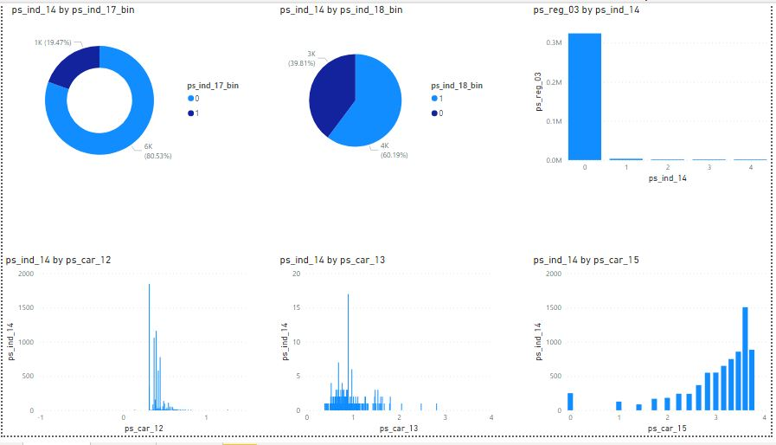

Slide 4
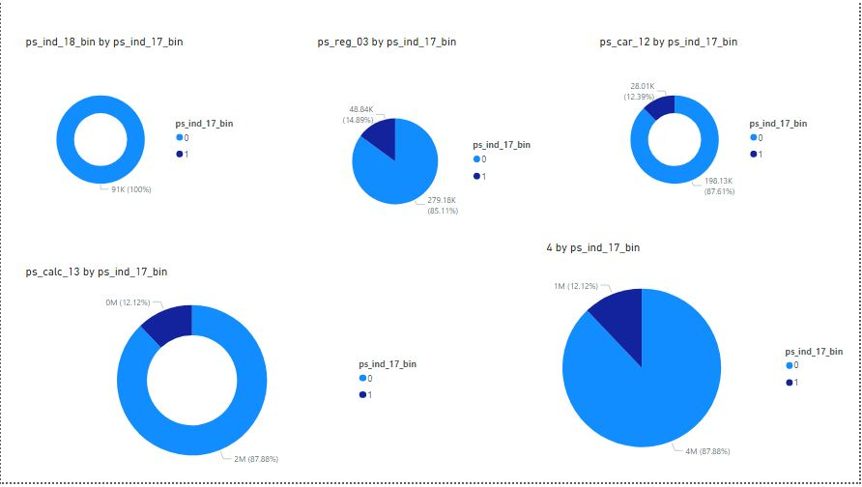

Slide 5
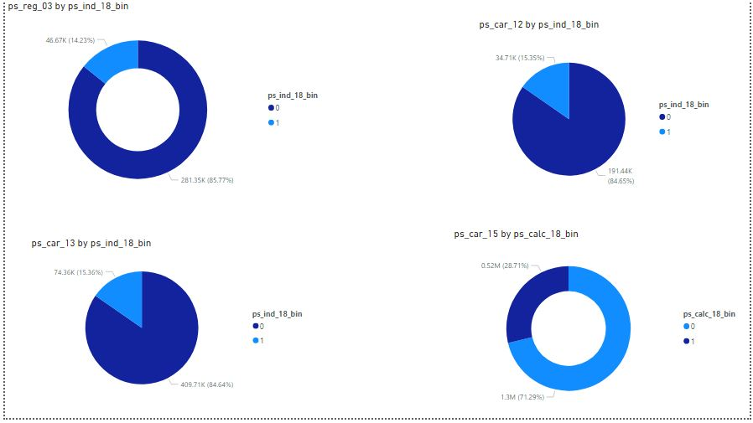

Slide 6
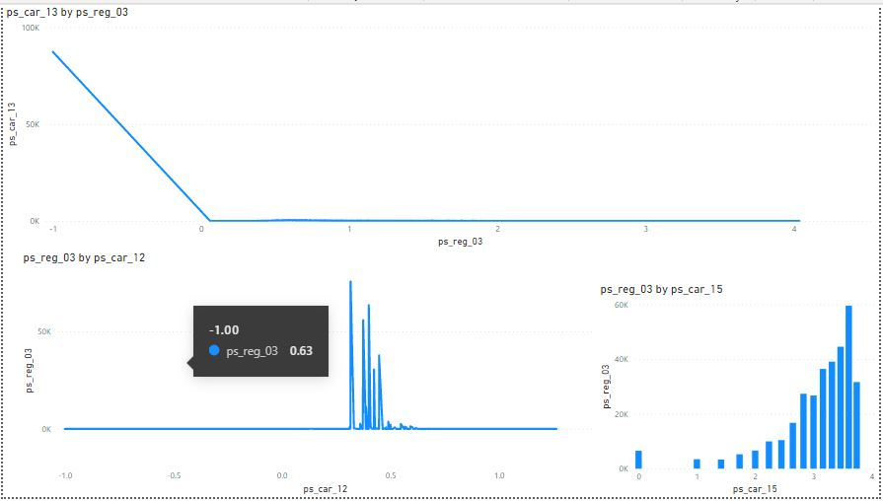

Slide 7
